Slide 1
p5.play Library
JavaScript libraries
Sprites
Animation
Movement
Collision Detection
Notes:
Ok, let’s get started.
P5 play library is about game development.

Slide 2
Working with libraries
Up to this point we have been writing our own code for collision detection, animation, etc.
The advantage of software, unlike physical materials, is that it can be reused with little or no expense
In fact it is arguably better to reuse software than rewrite it each time, particularly for common tasks
Some tasks can be very complex, for example: 3D graphics, physics, image processing
Using a library you may not need to understand how to implement those at all

Slide 3
p5.play Library
p5.play is a library of functions for:
sprites
animation
collision detection
Notes:
It focuses on interactions and animations because game requires a lot of theses.

Slide 4
Using p5.play
p5.play was VERY recently (August) updated to version 3.
Our early testing of this version has found a few bugs that we are not happy with, so we will be using the previous version (version 2.3).
A link to the 2.3 download is on the next slide, and version 2.3 of p5.play is also on L@G. The documentation for 2.3 is located at:
https://p5play.org/v2/docs/index.html

Slide 5
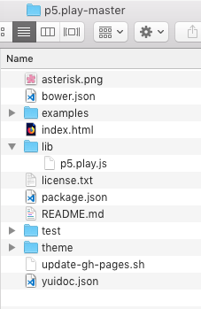
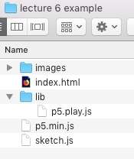
Using p5.play
p5.play is a single JavaScript file that provides additional functions for our application to use
To use p5.play you will need to:
Download p5.play and unzip
The p5.play download includes a lot of additional files, the only file you need is p5.play.js in the lib folder
You can copy the entire lib folder into your p5 project:

Slide 6
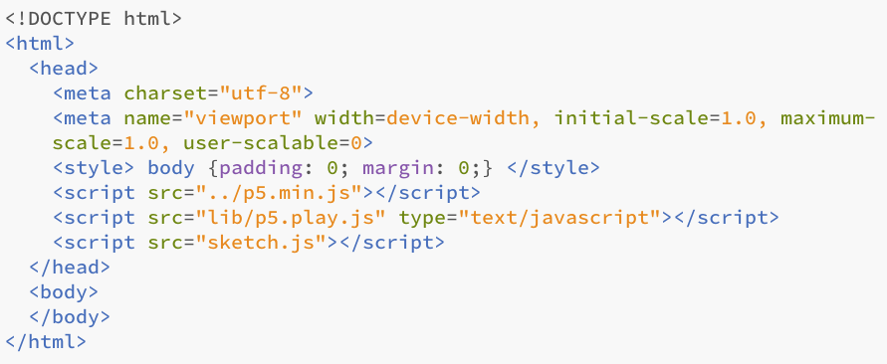
Including JavaScript libraries
The way to utilise JavaScript libraries is to include them in the HTML <head>:

Slide 7
Sprites

Slide 8
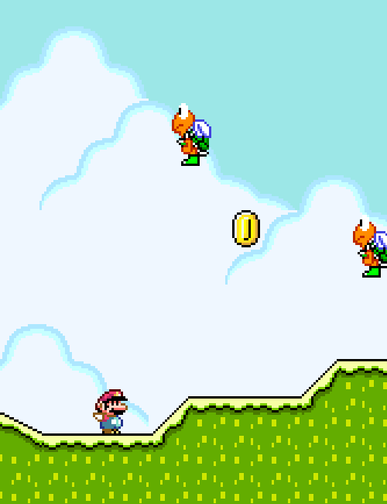
Sprites
2D computer games use a concept called a sprite
Wikipedia defines a sprite as:
"Use of the term sprite has expanded to refer to any two-dimensional bitmap used as part of a graphics display, even if drawn into a frame buffer (by either software or a GPU) instead of being composited on-the-fly at display time."
In p5.play a sprite is an object with multiple properties including:
An image (or a series of animated images)
Position on the canvas
Rotation (and rotation animation)
Animation path
Ability to handle collisions
Handle mouse events

Slide 9
Creating a sprite
To create a sprite use the createSprite() function
The createSprite() function takes the x and y location of the sprite (which will be the centre of the sprite) and the width and height of the sprite, e.g.:
createSprite(200, 200, 50, 50);

Slide 10
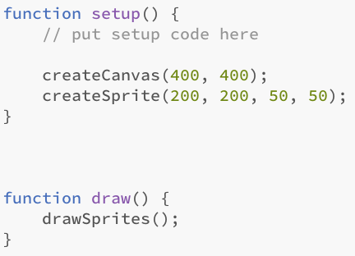

Drawing a sprite
Simply creating a sprite will not cause it to appear on the canvas
We can either draw each sprite individually or draw them all at once with the drawSprites() function, which should be placed inside the draw() function
The following example creates one sprite and draws it:

Slide 11
Adding an image to the sprite
In the previous example we didn't add an image to the sprite so p5.play chooses a random colour to draw it
Sprites should have at least one image
The image should be preloaded in the preload() function and then added to the sprite
To be able to add the image to the sprite we will need to store the sprite in a variable

Slide 12
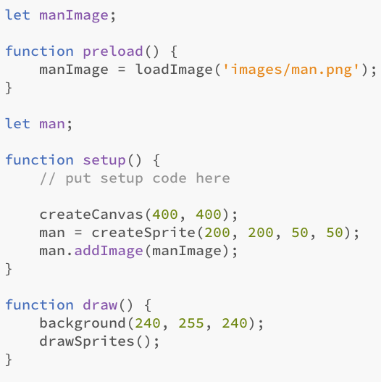
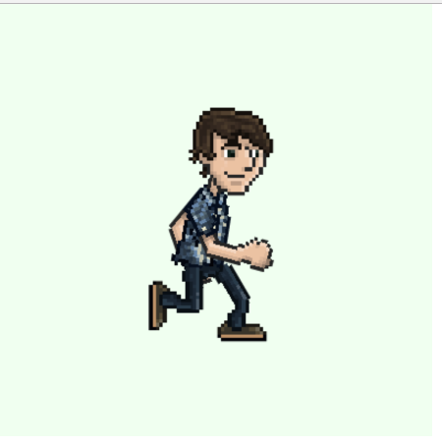
Add image to sprite
In the following example an image is preloaded, the sprite is stored in a variable, and then the image is added to the sprite:

Slide 13
Animation

Slide 14
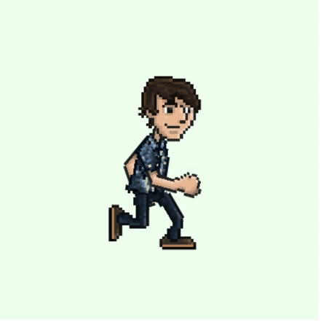
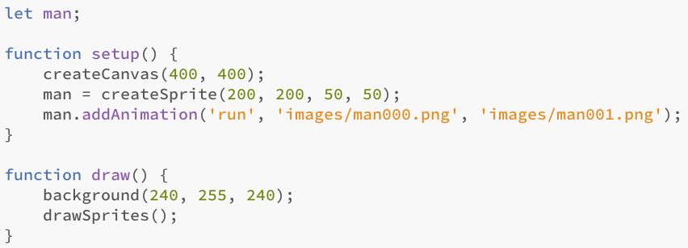
Sprite animation
In the previous example the sprite had one image
We can set up an animation of multiple images
We use the addAnimation() function instead of addImage() and specify the start and end animation files
In addition we also give the animation a label, as a sprite might have multiple animations:

Slide 15
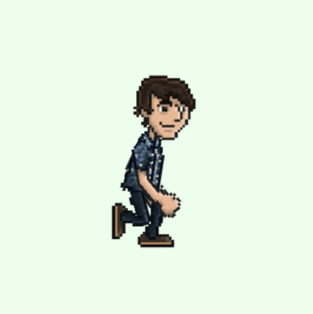
Multiple images
The addAnimation() function is smart enough to be able to load multiple images with just the first and last file names (assuming they are numbered):

Slide 16
Movement

Slide 17
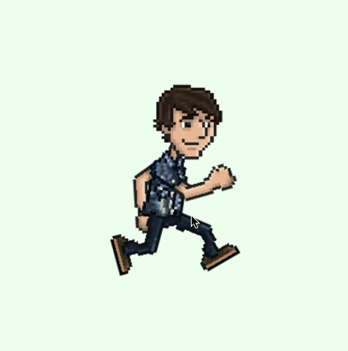
Velocity
p5.play provides a number of functions to move objects at a certain velocity
The setVelocity() function takes in two parameters which represent the movement in x and y pixels per frame
man.setVelocity(1, 0);

Slide 18
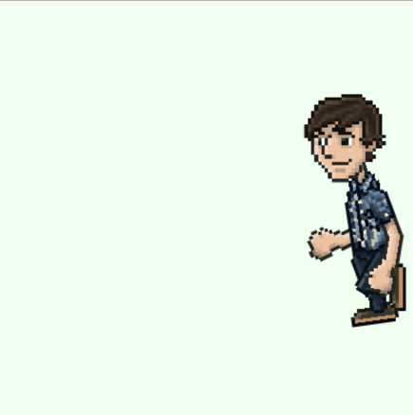
Mirror
p5.play provides mirrorX() and mirrorY() functions which can flip the sprite
This is useful if you want the sprite to face in the other direction
Pass in 1 for normal direction and -1 for mirrored:
man.mirrorX(-1)

Slide 19
Speed
In addition to the setVelocity() function which effectively takes a vector as parameter, the setSpeed() function takes a scalar speed and angle
Note that the angle in setSpeed() is in degrees, e.g.:
setSpeed(5, 45);

Slide 20
Collision Detection

Slide 21
Collider box
p5.play provides support for collision detection based on ellipse or rectangle shapes
Even though the image for the sprite is a rectangle (and may effectively be another shape as a result of transparency), the collider box is what will determine collisions
By default the collider box is the rectangle of the sprite image
e.g.:
sprite.setCollider('circle', 0, 0, 50, 50);

Slide 22
Overlap
The overlap() function returns true if the passed in sprite overlaps, e.g.:
if (sprite1.overlap(sprite2))
print("sprites overlap");
overlapPoint() checks if a point is inside the sprite's collider box:
sprite1.overlapPoint(34, 54)

Slide 23
Overlap pixel
The sprite box may be too coarse as a collider, the overlapPixel() function will return true if the pixel is a non-transparent pixel

Slide 24
Collide
p5.play also provides collision behaviour
The collide() function will prevent two sprites from overlapping
e.g. sprite1 will not be allowed to overlap sprite2:
sprite1.collide(sprite2);
See an example here

Slide 25
Displace
The displace() function will cause the sprite to move the other sprite
sprite1 will cause sprite2 to move when they overlap:
sprite1.displace(sprite2)

Slide 26
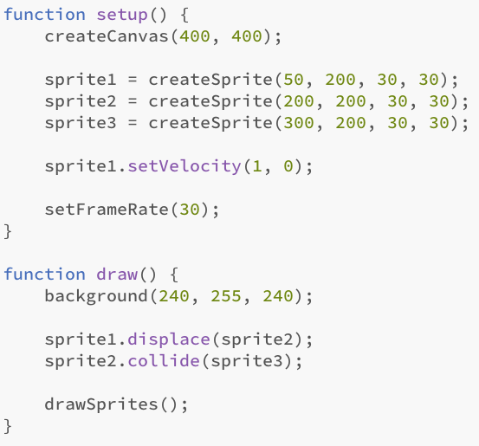
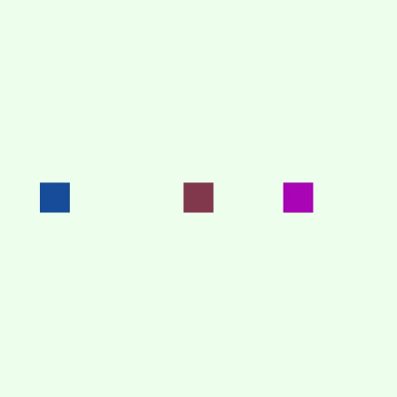
Example
The displace() and collide() functions must be placed in the draw() function to be checked for each frame:

Slide 27
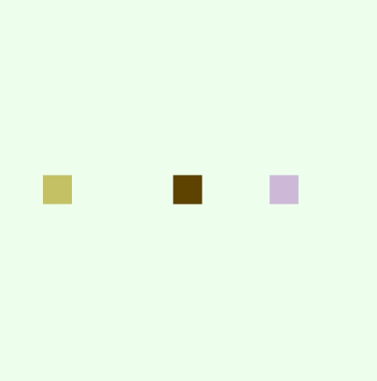
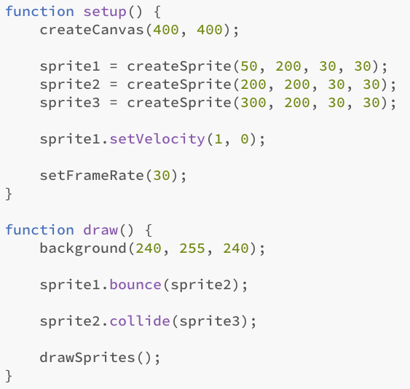
Bounce
Bounce will cause another sprite to bounce off it

Slide 28
Rotation

Slide 29
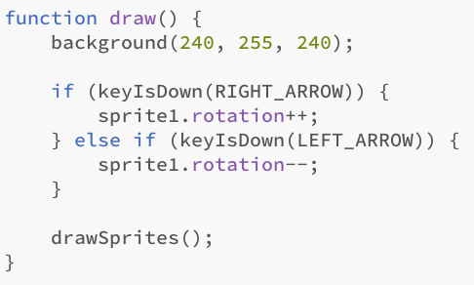
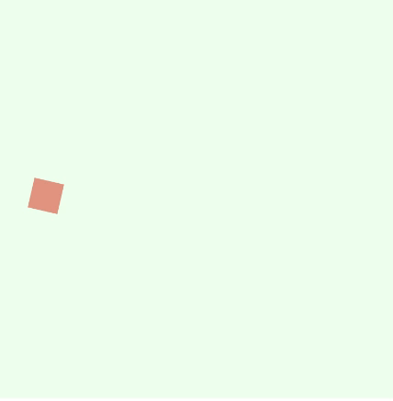
Rotation
The rotation of a sprite can be set in degrees using the rotation property, e.g.:
sprite.rotation = 90;
The following example rotates a sprite left and right using the arrow keys:

Slide 30
Rotation Speed
A sprite can be left rotating at a constant speed using the rotationSpeed property which represents the degrees per frame, e.g.:
sprite.rotationSpeed = 1;
The above example will rotate the sprite 1 degree per frame, or 60 degrees per second if the frame rate is 60 frames per second
Note that rotation speed does not affect the direction a sprite may be moving in

Slide 31
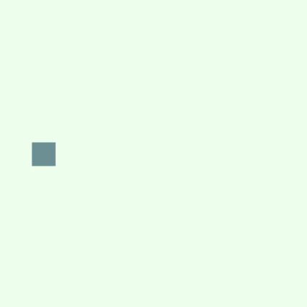
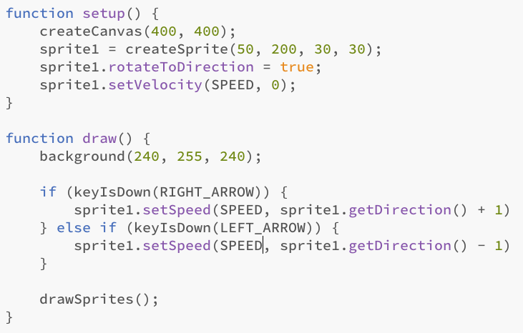
Rotate to direction
You may want an object to automatically face in the direction it is moving
This can be set with the rotateToDirection property, e.g.:
sprite.rotateToDirection = true;
The following example changes the direction of the moving sprite which also changes the rotation.

Slide 32
Physics

Slide 33
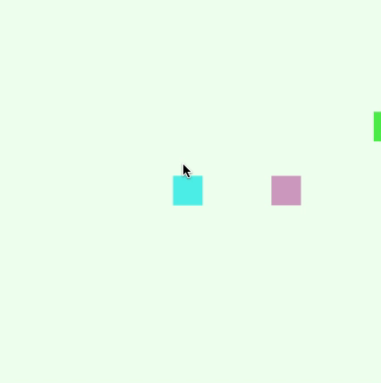
Attraction
An attraction point can be set for a sprite which will cause it to accelerate towards the point (similar to gravity):
attractionPoint(speed, x, y)
This example sets the attraction point to the mouse location and adds 1 to the current speed:
sprite.attractionPoint(1, mouseX, mouseY);
You can see in the example that the sprite has a lot of energy and doesn't appear to ever move towards the mouse location

Slide 34
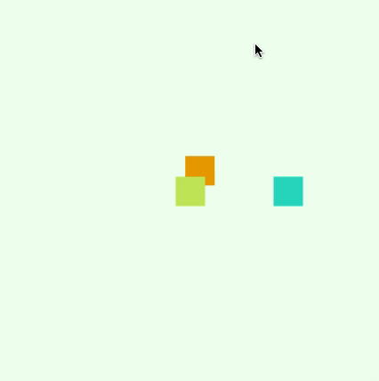
Friction
In the previous example the sprite has no friction
If we add a small amount of friction the sprite will move towards the mouse:
sprite.friction = 0.1;

Slide 35
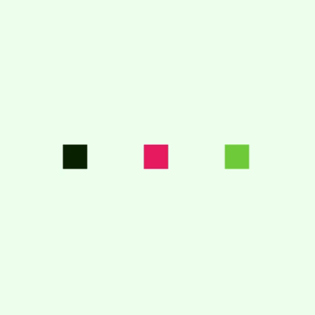
Mass
In the bounce example we saw that the moving sprite stopped and all of its energy was transferred to the other sprite
If the sprites have different mass we get a different result
By default all sprites have a mass of 1
In this example sprite2 has a mass of 2
sprite2.mass = 2;

Slide 36
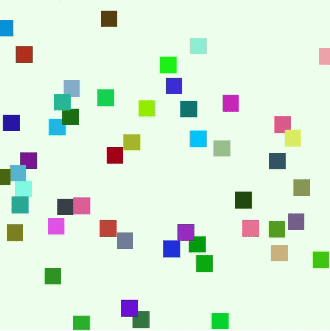
Circle collider
The following example sets the collider to 'circle' and tests for bounce between 50 sprites:

